Slide 1
Car Price Prediction
By Surjeet Singh

Slide 2
Problem Statement
Structure of used car market have been changing after Covid19
People are trying to get a car for their family
Due to rise of electric vehicle, people are buying EV and selling their old car

Slide 3
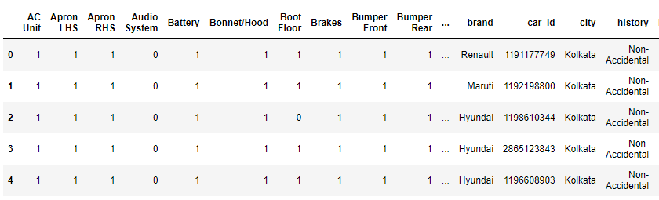
Data Collection
Data collected from the website of cars24
Web scrapped 58 features
Filtered the data by removing the cars of price Rs. 0

Slide 4
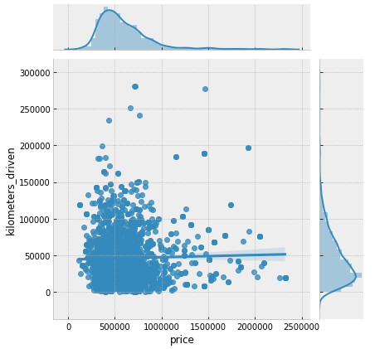
EDA
plotted histograms for each features
Found only 37 missing values in categorical column
Filled missing values with mode
Most of the car prices are below Rs. 1500000
filtered the data below price Rs. 1500000
Most of the cars are driven less than 150000
Filtered the data with kilometers below 150000

Slide 5
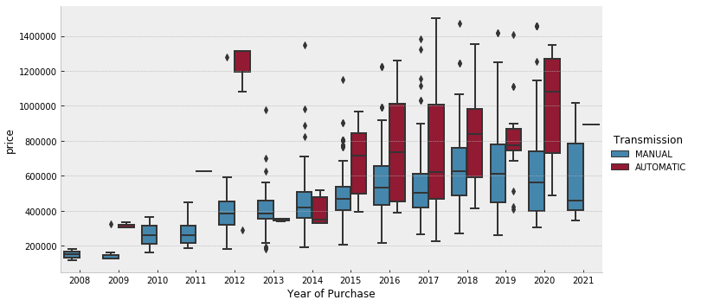
EDA
Older cars are cheaper than the newer one (obviously)
Trend of automatic transmission increased
Price of automatic transmission is more than manual

Slide 6
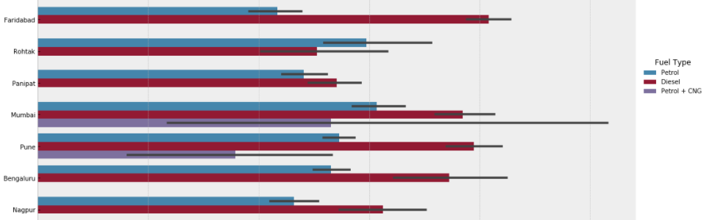
EDA
Fuel type affect price
Diesel cars has higher price
Diesel car has better mileage
CNG has low price and it is not available in all cities

Slide 7
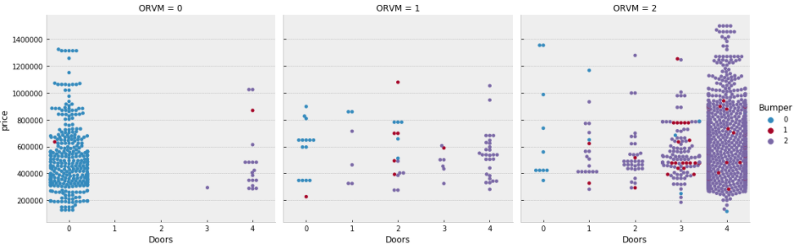
EDA
Car having all doors perfect have little bit higher price
Defected doors also have defected ORVM

Slide 8
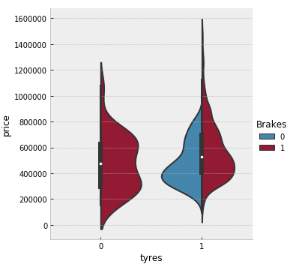
EDA
Cars having better tyres and brakes conditions have higher price

Slide 9
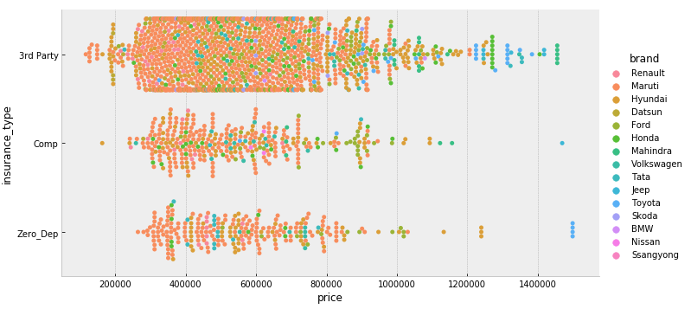
EDA
Most of the market is captured by Maruti Suzuki, hyundai and Tata
Most of them have third party insurance

Slide 10
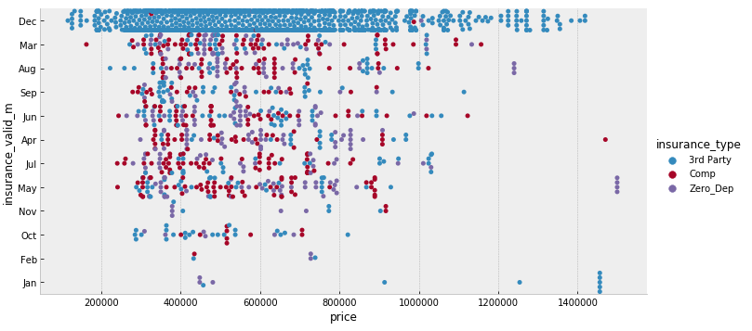
EDA
Most of the cars has 3rd party insurance
Most of the people buy insurance in january for one year
Comp and zero dept has a spread over the year

Slide 11
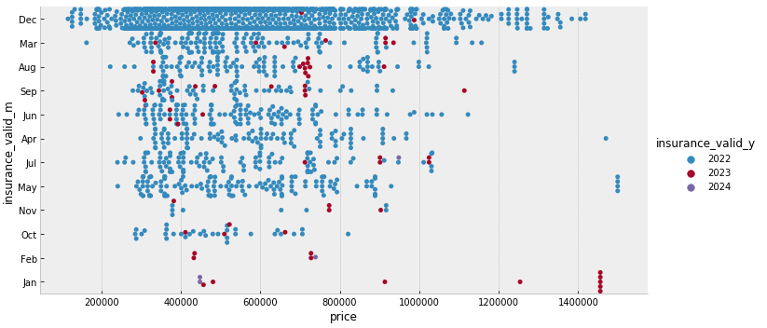
EDA
Most of the insurance are going to end in the year of 2022
Few cars have insurance till year 2023
very rare car has insurance till 2024

Slide 12
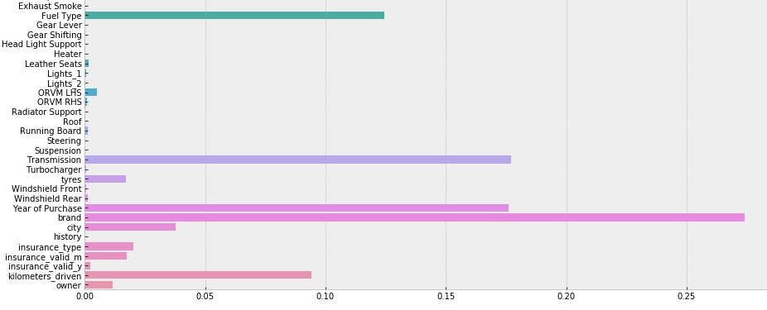
Important Features
Quickly trained decision tree model
Determined the feature importance
Preferred only important features to feed the model

Slide 13
Feature Engineering
Merged the columns containing similar data (ex. Doors)
Info in Previous Data | New Data
All doors are perfect | 4
3 perfect, 1 defected door | 3
2 perfect, 2 defected door | 2
1 perfect, 3 defected door | 1
All doors defected | 0
Previously this information was in 4 different columns
Only single column in new data
Similar pattern followed for some other features such as lights

Slide 14
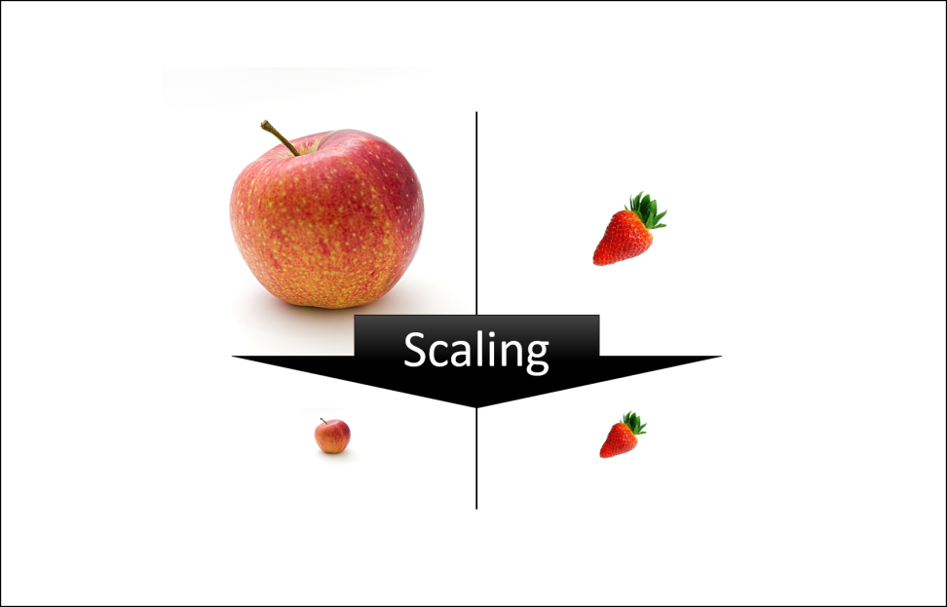
Feature Scaling
Different features has different range of values
Some features has very small values and some has very large
ML Model might converge slowly for such data
Standard scalar used to scale the data

Slide 15
Label Encoding
ML models can only accepts numbers
Some features have values as string such as insurance type, fuel type
Label encoder used to convert strings into numbers
Insurance Type Label Encoding
Actual | After Encoding
Third Party | 0
Comprehensive | 1
Zero dep. | 2

Slide 16
ML Models
Model | Accuracy
Logistic Regression | 0.39
Decision Tree | 0.59
Random Forest | 0.78
Gradient Boost | 0.64
Extra Trees | 0.75
Best model is random forest
Fine Tuned to get improve the accuracy

Slide 17
Conclusion
Random Forest has performed best among all the models
Accuracy can be improved by including some more important features
Body type, car model continuing by company can also be considered

